Slide 1
ESTHER

Slide 2
ESTHER
¹ By the rivers of Babylon,
There we sat down, yea, we wept
When we remembered Zion.
² We hung our harps
Upon the willows in the midst of it.
³ For there those who carried us away captive asked of us a song,
And those who plundered us requested mirth,
Saying, “Sing us one of the
songs of Zion!”
⁴ How shall we sing the Lord’s song
In a foreign land?
⁵ If I forget you, O Jerusalem,
Let my right hand forget its skill!
⁶ If I do not remember you,
Let my tongue cling to the roof of my mouth—
If I do not exalt Jerusalem
Above my chief joy.
Psalm 137:1-6

Slide 3
ESTHER
Find an attractive prisoner of war, bring her home, shave her head, trim her nails, and give her new clothes. Then she's yours. - (Deut. 21:11-13)
Cut 200 foreskins off your future father-in-law's enemies and get his daughter for a wife - David (I Samuel 18:27)
Kill any husband and take HIS wife (Prepare to lose four sons, though). - David (2 Samuel 11)
Find a prostitute and marry her. - (Hos. 1:1-3)
Become the emperor of a huge nation and hold a beauty contest. - Xerxes or Ahasuerus (Esther 2:3-4)
Purchase a piece of property, and get a woman as part of the deal. - Boaz (Ruth 4:5-10)
Go to a party and hide. When the omen come out to dance, grab one and carry her off to be your wife. - Benjaminites (Judges 21:19-25)
Don't be so picky. Make up for quality with quantity. - Solomon (1 Kings 11:1-3)
Biblical Ways to Obtain a Wife

Slide 4
ESTHER
Darius I
Xerxes I
500 BC
490 BC
480 BC
470 BC
Esther Crowned479 BC
Battle of Marathon
490 BC
Battle of Thermopylae 480 BC
Battle of Salamis480 BC
The Persian Empire

Slide 5
ESTHER
Esther (Star) is her Persian name
Hadassah (Myrtle) is her Hebrew name

Slide 6
ESTHER
250,000-300,000 people die each day
3,700 abortions (U.S.) each day

Slide 7
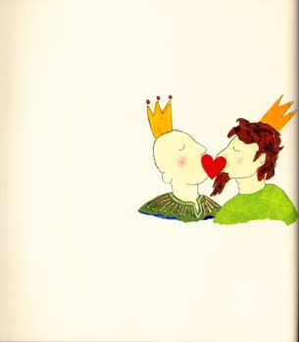
ESTHER
Read to 2nd Graders

Slide 8
ESTHER
Also I heard the voice of the Lord, saying: "Whom shall I send, And who will go for Us?" Then I said, "Here am I!
me."
Send
Serve
Isaiah 6.8

Slide 9
ESTHER
"In Germany, they came first for the Communists, And I didn’t speak up because I wasn’t a Communist;
And then they came for the trade unionists, And I didn’t speak up because I wasn’t a trade unionist;
And then they came for the Jews, And I didn’t speak up because I wasn’t a Jew;
And then... they came for me... And by that time there was no one left to speak up."
Martin Niemöller, 1946

Slide 10
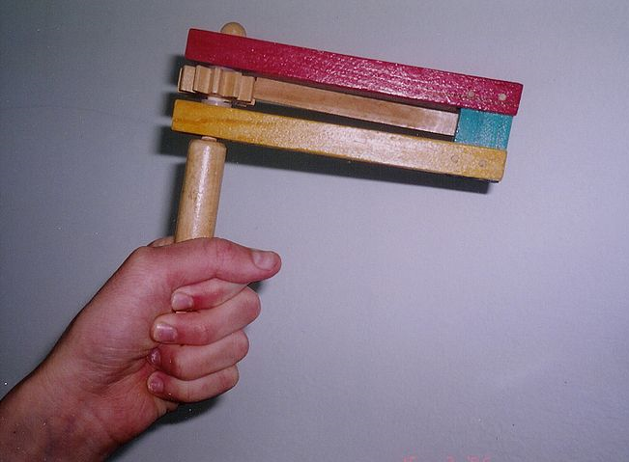
ESTHER
"Cursed be Haman”
"Blessed be Mordecai"
Purim “Gragger”

